Slide 1

The Prediction of Cerebral Palsy in Infants
By
Name 1: Thokala Rohith Sai (22BFA33321)
Name 2: Kavali Gnananjali(23BFA33L11)
Name 3: Bhukya Kiran Kumar (22BFA33285)
Name 4: Boddu Guru Vignesh (22BFA33286)
Under the guidance of
Dr P.Lokesh Kumar Reddy
Designation
DEPARTMENT OF COMPUTER SCIENCE AND ENGINEERING (AI & ML)
SRI VENKATESWARA COLLEGE OF ENGINEERING
(Autonomous)
Karakambadi Road, Tirupati-517507
2022-2026

Slide 2
OUTLINE
Abstract
Introduction
Problem Statement
Existing system
Disadvantages
Proposed system
Advantages
System Requirements
Modules
Architecture

Slide 3
ABSTRACT
Cerebral Palsy (CP) is a group of permanent neurological disorders that affect movement, posture, and muscle coordination, often caused by abnormal brain development or brain injury during early life.
Early prediction of cerebral palsy in infants is critical, as timely intervention can significantly improve motor functions and quality of life.
However, early diagnosis remains challenging due to subtle clinical signs in newborns and the variability in symptom progression.
This project focuses on developing an intelligent prediction system using machine learning techniques to identify infants at high risk of cerebral palsy at an early stage.
The proposed system integrates clinical data, neurodevelopmental assessments, and medical imaging features to build a predictive model capable of identifying CP risk with high accuracy.
Advanced machine learning algorithms are employed to analyze complex patterns that are difficult for traditional methods to detect.

Slide 4
INTRODUCTION
Cerebral Palsy (CP) is a lifelong neurological condition that affects posture, movement, and motor coordination. Early diagnosis—especially during the first few months of life—greatly improves the effectiveness of intervention programs and supports better long-term developmental outcomes.
Traditionally, CP diagnosis relies on clinical evaluation, neuroimaging, and General Movement Assessment (GMA). While GMA is highly sensitive, it requires trained experts, manual video interpretation, and is prone to variability and subjectivity.
By extracting skeletal keypoints from infant movement videos and analyzing their spatial–temporal patterns, deep learning models can identify subtle motor abnormalities that are difficult to detect manually.
To address these issues, the proposed project introduces a hybrid deep learning system that combines pose estimation, data preprocessing, and multi-model classification to predict CP risk in infants aged 3–5 months.
Using CNN-LSTM, CNN-GRU, and GCN-GRU hybrid models, along with majority voting techniques, the system aims to provide an accurate, objective, and reliable diagnostic tool. This approach supports early medical decision-making and enhances the potential for timely therapeutic interventions.

Slide 5
PROBLEM STATEMENT
Cerebral Palsy (CP) is often diagnosed late because early symptoms are subtle, vary widely among infants, and depend heavily on expert interpretation of movement behavior. Traditional assessment methods—such as manual observation of infant videos and General Movement Assessment (GMA)—are subjective, slow, and require highly trained specialists, making early screening inaccessible in many healthcare settings.
To overcome these challenges, there is a need for an automated, objective, and scalable system capable of analyzing infant movement in real time. By using pose estimation to extract skeletal keypoints from video data and applying hybrid deep learning models to classify abnormal motor patterns, the proposed solution aims to accurately predict early signs of CP and support clinicians in timely diagnosis and intervention.

Slide 6
EXISTING SYSTEM
In the existing system, cerebral palsy diagnosis primarily relies on clinical observation, neurological examinations, and developmental milestone tracking over time.
Pediatric neurologists assess motor delays, abnormal muscle tone, reflex patterns, and posture to identify potential CP cases.
Imaging techniques such as MRI and CT scans are used to observe brain abnormalities, but these are often conducted only after symptoms become evident.
Despite their clinical value, existing methods suffer from delayed diagnosis, subjectivity, and dependence on specialist expertise.
Early symptoms are often subtle and may be overlooked, leading to late intervention.
Additionally, manual assessment processes are time-consuming and prone to human error, making it difficult to consistently identify high-risk infants during the critical early developmental window.

Slide 7
DISADVANTAGES
Highly Subjective: Manual GMA depends on expert experience and may vary between evaluators.
Time-Consuming: Long video recordings and frame-by-frame analysis slow down diagnosis.
No Public-Friendly Tools: Most ML models are not deployed as web applications, limiting accessibility.
Low Scalability: Traditional assessments cannot be applied efficiently to large populations.
Pose Estimation Limitations: Existing approaches may use inaccurate or computationally heavy models.
Lack of Automated Analysis: Basic ML models fail to capture complex temporal–spatial movement patterns.
Inconsistent Detection: Misclassification due to noisy data, infants’ movement variability, or limited datasets.

Slide 8
PROPOSED SYSTEM
The proposed system introduces a machine learning-based predictive framework to identify the risk of cerebral palsy in infants at an early stage.
The system uses structured clinical data, prenatal and perinatal history, infant motor assessments, and optional neuroimaging features to train predictive models.
Algorithms such as Random Forest, Support Vector Machine, and Neural Networks are employed to capture complex relationships among risk factors.
This intelligent system provides automated risk classification, categorizing infants as low-risk or high-risk for cerebral palsy.
The predictive output assists clinicians in decision-making rather than replacing medical judgment.
By enabling early identification, the proposed system supports timely therapeutic interventions, continuous monitoring, and improved long-term developmental outcomes for infants.

Slide 9
ADVANTAGES
One of the major advantages of the proposed system is early and accurate prediction, allowing intervention during the critical neuroplasticity phase of infant development.
Machine learning models can analyze large volumes of medical data and uncover hidden patterns that traditional diagnostic approaches may miss.
This improves diagnostic consistency and reduces reliance on subjective clinical interpretation.
Another significant advantage is scalability and decision support. The system can be deployed in hospitals, neonatal care units, and rural healthcare centers to assist clinicians with limited specialist availability.
It reduces diagnosis time, improves screening efficiency, and enhances overall healthcare delivery by providing data-driven insights for infant neurological assessment.

Slide 10
SYSTEM REQUIREMENTS
Hardware Requirements :
Processor | : Intel Core i5 (6-core) or AMD Ryzen 5
RAM | : 16 GB recommended (8 GB minimum).
Hard Disk | : 250 GB SSD
Monitor | : Standard Display
GPU | : NVIDIA GPU with CUDA Support

Slide 11
SOFTWARE REQUIREMENTS
Operating System | : Windows 10/11
Programming Language | : Python 3.8-3.11
Web-Server | : Flask Web Server
Frontend | : HTML, CSS, Java Script
Backend | : MySQL, flask
Deep Learning | : Pytorch

Slide 12
MODULES
Module 1: Data Collection Module
This module gathers infant-related data including prenatal history, birth details, Apgar scores, motor assessments, and neurological observations.
Data may be collected from hospital records, neonatal monitoring systems, and clinical evaluations.
The collected data is securely stored and prepared for preprocessing.
Proper anonymization and standardization techniques are applied to ensure data privacy and consistency across multiple healthcare sources.

Slide 13
Data Preprocessing Module
This module cleans the collected data by handling missing values, removing outliers, and normalizing numerical features.
Categorical attributes are encoded to make them suitable for machine learning algorithms.
Feature selection techniques are applied to identify the most relevant risk factors influencing cerebral palsy prediction.
This improves model efficiency, reduces overfitting, and enhances overall prediction accuracy.

Slide 14
Feature Extraction and Analysis Module
In this module, meaningful features are extracted from clinical and developmental datasets.
Statistical analysis and correlation methods are used to understand relationships between different infant health indicators.
Advanced feature engineering techniques transform raw medical data into structured inputs suitable for predictive modeling.
This step plays a crucial role in improving the robustness and reliability of the prediction system.

Slide 15
Machine Learning Model Training Module
This module trains multiple machine learning models using the processed dataset.
Algorithms such as Logistic Regression, CNN, SVM, and Bidirectional LSTM (BiLSTM) are evaluated to determine the best-performing model.
Cross-validation and performance metrics like accuracy, precision, recall, and F1-score are used to assess model effectiveness.
The optimal model is selected for deployment based on predictive performance.

Slide 16
Prediction and Decision Support Module
This module provides real-time prediction results for new infant data.
The trained model classifies infants into risk categories and generates alerts for high-risk cases.
The system presents results through a user-friendly interface for clinicians, enabling easy interpretation and follow-up planning.
This module supports early diagnosis, continuous monitoring, and informed clinical decision-making.

Slide 17
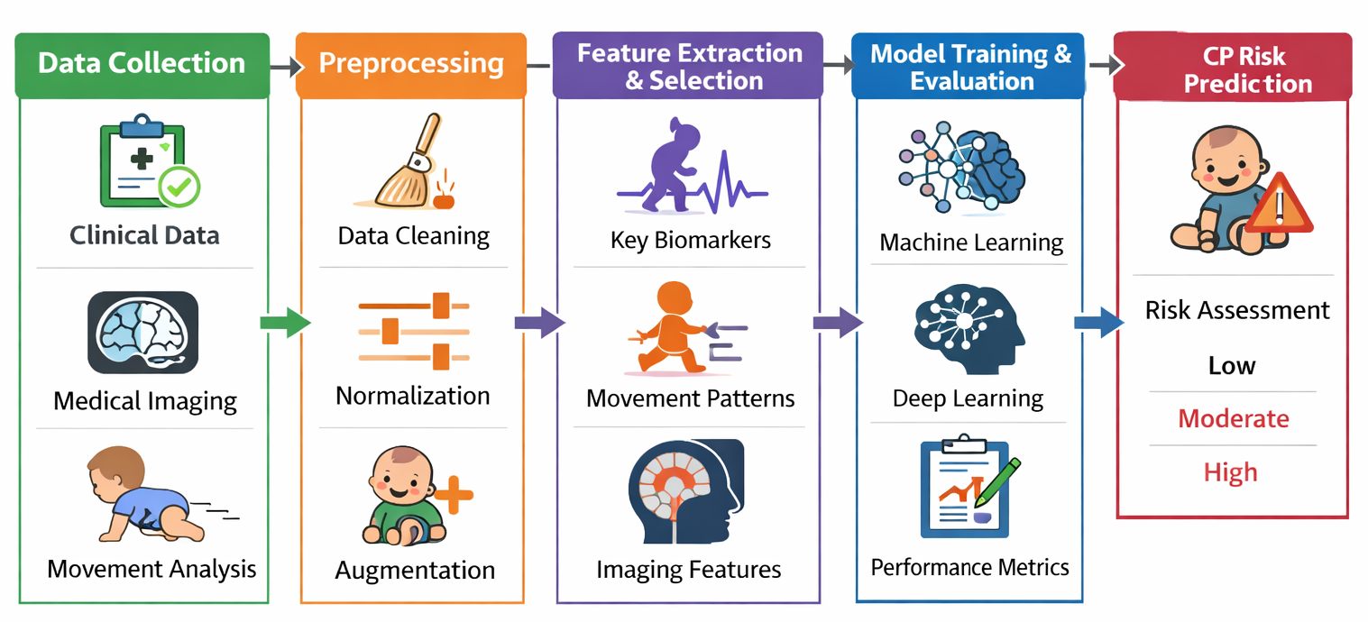
ARCHITECTURE

Slide 18
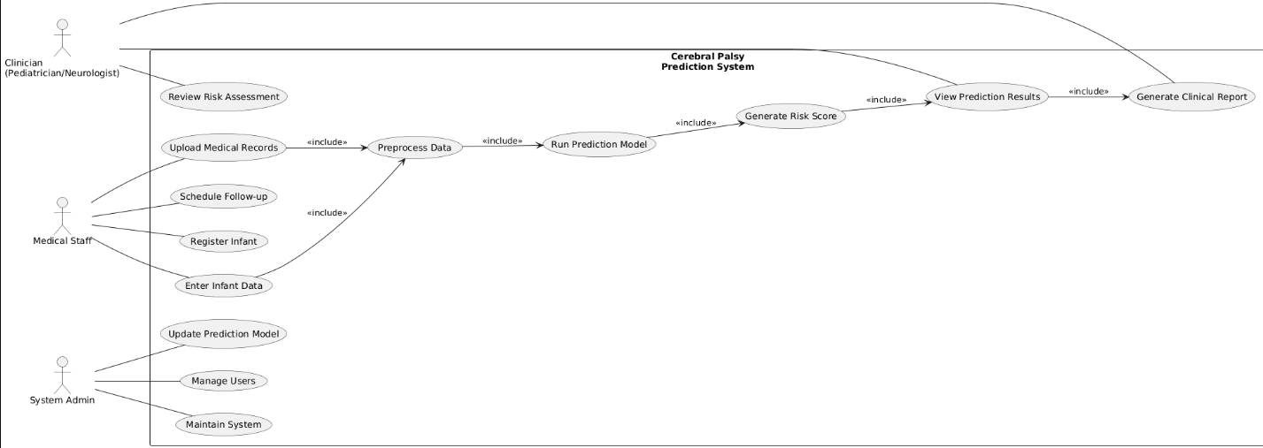
USE CASE DIAGRAM

Slide 19
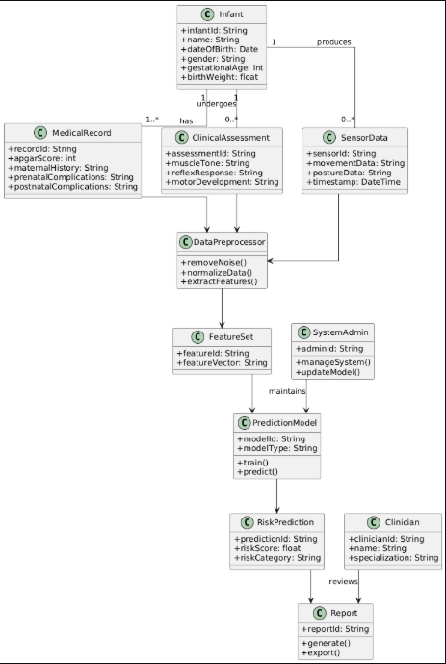
CLASS DIAGRAM

Slide 20
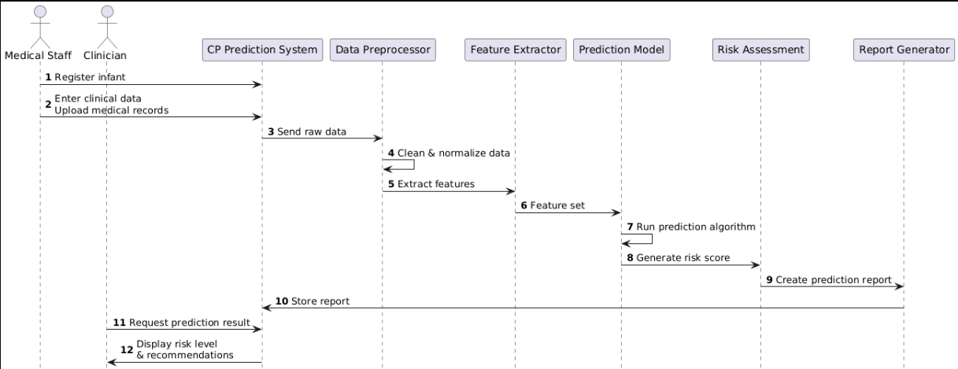
SEQUENCE DIAGRAM

Slide 21
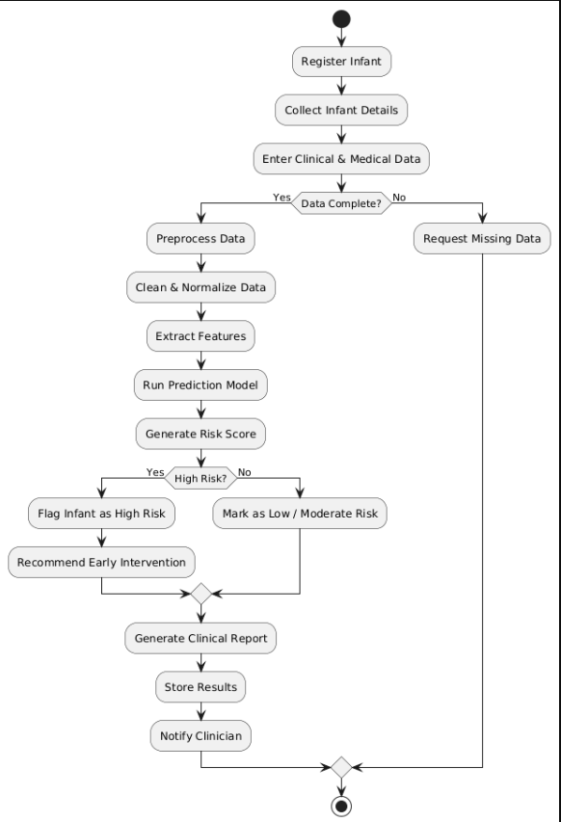
ACTIVITY DIAGRAM

Slide 22


